Slide 1


Voya Financial Data Challenge
Team 10
Vinay vihari lakamsani
Anisha Balakrishnan
Shiva

Slide 2
Introduction
Data:
Email Data with customer interactions
Testing period: January 2017 to June 2018
Event: Email sent to a customer
Success: Open and Click event type considered to be Success
Failure: All other event types are considered to be Failure
Working Approach:
Exploratory Data Analysis from Voya Financial Email data
Data driven insights on Email responses
Ideal Recommendations for better customer interaction

Slide 3
Exploratory Data Analysis
Email file consisting of 2.6M rows & Interactions file with 483K rows are considered for analysis
Campaign ID is used to identify unique category of Emails sent and considered as Primary key
Advisory ID is used to identify unique recipient and considered as Secondary key
Both the files merged on primary and secondary keys to identify the ratio of mails with responses to the total mails sent
Email sent dates and Interaction date were considered for Time series analysis
Subject line of the emails was used to create buckets based on which ideal combinations were identified

Slide 4
Exploratory Data Analysis
Calculated fields:
Subject_length: Number of characters in each Email subject
Number_of_words: Number of words in each subject
Month: Month in which an email was sent
Week_day: Day on which an email was sent
Number_of_mails_per_campaign: Number of emails sent in a particular Email campaign
Number_of_mails_sent_per_each_advisory_id: Number of emails sent to a particular customer

Slide 5
Modeling Techniques
Visualization
insights
Modeling Algorithms
Used tableau to create data visualizations to identify the trend in success ratio of emails based on Subject Lines & Interaction dates
Training Algorithm to predict the success based on email characteristics. Hence, better understanding of customer behaviour

Slide 6
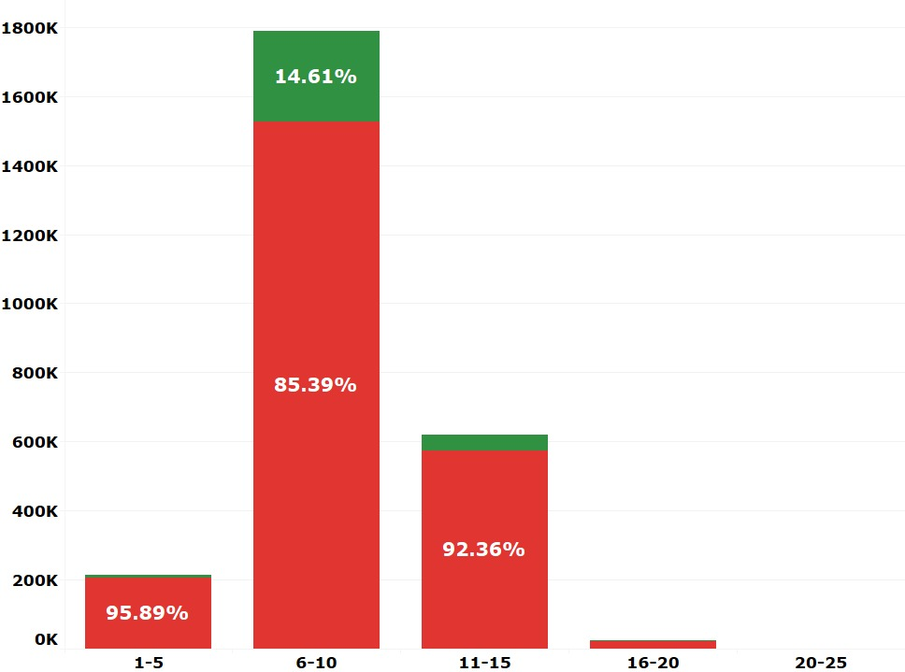

Recommendation 1: Send emails with concise subject lines
Email Subject lines with words ranging from 6 to 10 observed to have high open and click rates
Today, 61% of emails are opened and read on mobile devices. So, make sure that email campaigns are optimized for mobile devices
Well crafted subject lines will increase the open and click through rates
6 to 10 words deliver the highest open and click rate making 8 words an ideal subject line
Number of Emails
Number of words per subject

Slide 7
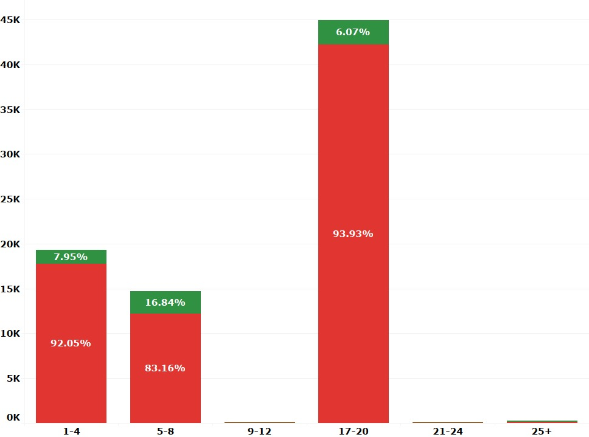
Recommendation 2: Send Out Right Number of Emails
According to given data, 5 to 8 emails per customer per month is a sweet spot
Sending more emails to a customer will have adverse effects
It is recommended to limit number of emails to 7 per customer per month
Number of Email Recipients
Number of characters per subject

Slide 8
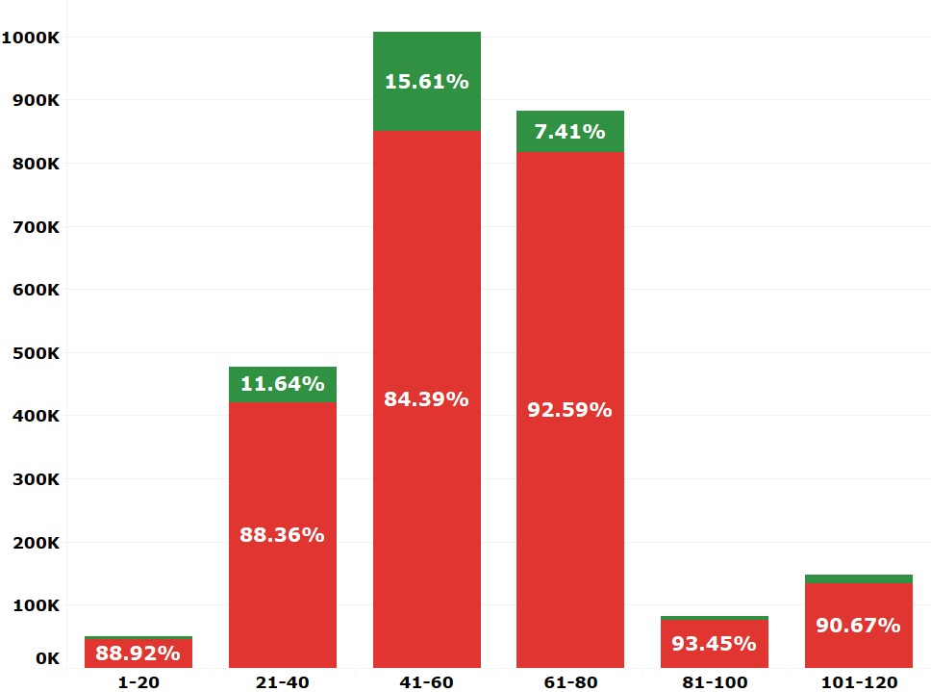
Recommendation 3: Reduce the no. of characters in subject lines
Email Subject lines with number of characters ranging from 41 to 60 observed to have high open and click rates
According to an online study, 55 characters seems to be a sweet spot for email subject lines
Click to open rate can be increased to 35% by using a specific personal name rather than a general email address or company name
Number of Emails
Number of characters per subject

Slide 9
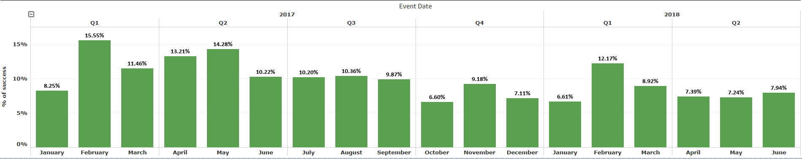
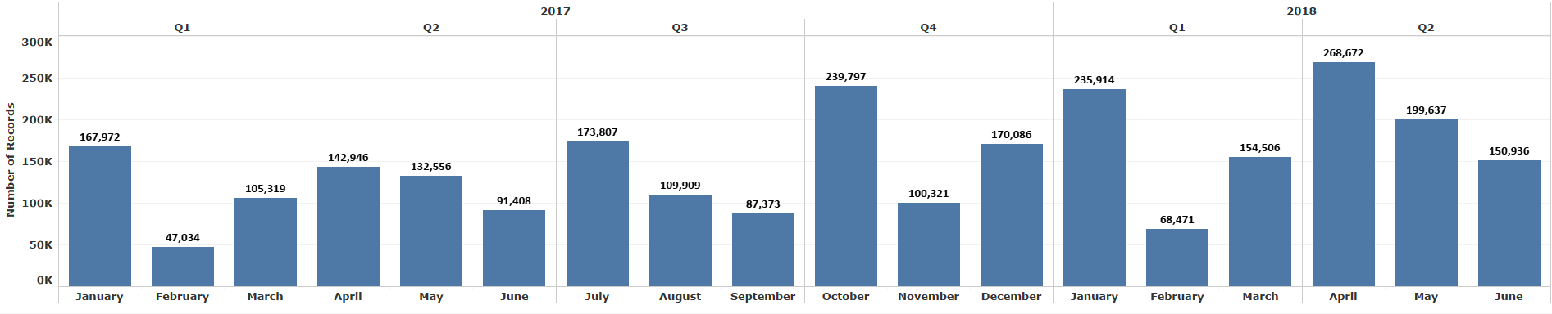
Recommendation 4: Send more emails in 2nd month of every quarter
Top visual: Percentage of successful emails based on months in different quarters
Bottom visual: Number of emails sent to the customers in different months
Observation: Success rate is observed high in the second month of every quarter despite more number of emails sent in the first month

Slide 10
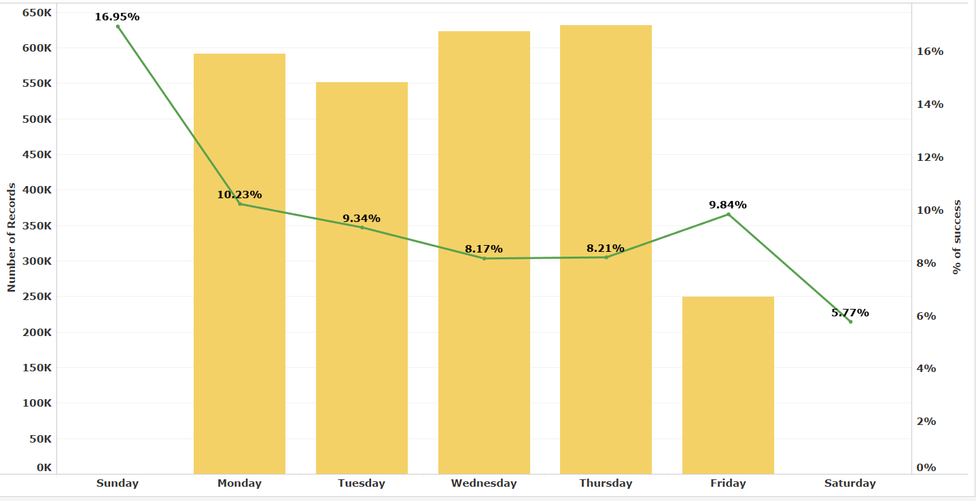
Recommendation 5: Best day to send emails
Visualization:
Number of emails sent is represented by bar graph
percentage of successful emails represented by Line
Observation:
Best day to send emails in order to achieve high success rate is Monday.
Weekdays are most active with more number of emails sent.
Friday also appears to have high success rate. Besides other days of the week, sending more emails on Friday would have more customer engagement.

Slide 11
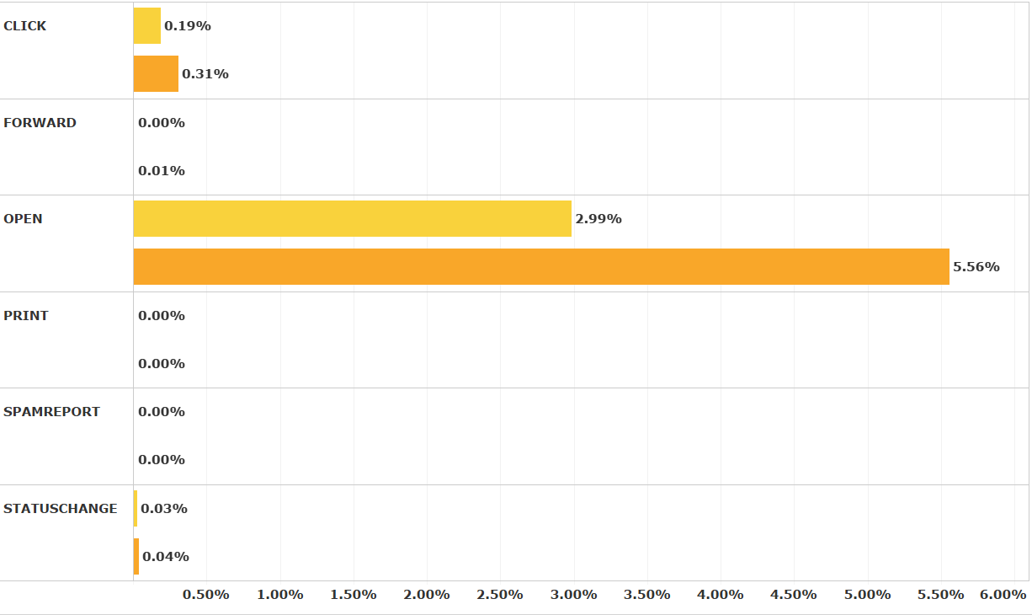
Variation of success rate over years
Distribution of user response for various event types
Percentage of open and click rates in 2017 is greater than that of 2018(though 2018 data is incomplete)
Email responses per year
Number of Emails Sent

Slide 12

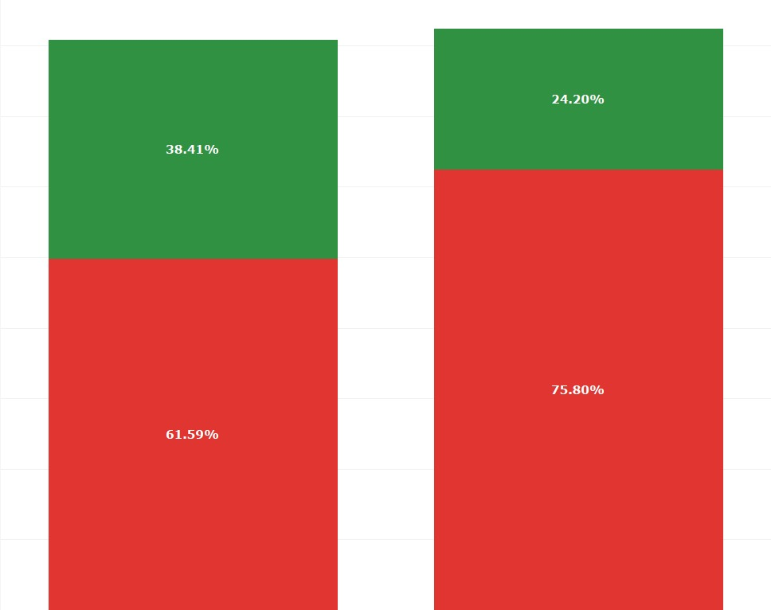
Ideal combinations of Email content
The Emails that were sent with
38% success rate is achieved with above combinations
The Emails that were sent with
24% success rate is achieved with above combinations
Month | January
Weekday | Monday
Product Positioning | 1
Email Category | Webinar/Call
Domain | Voyafa.com
Words length | 6 to 10
Number of Emails
Month | April
Weekday | Friday
Product Positioning | 1
Email Category | Global Perspectives
Domain | lpl.com
Words length | 6 to 10

Slide 13
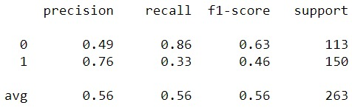
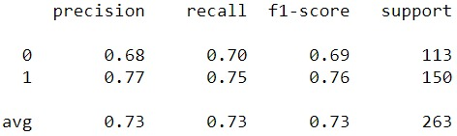
Predicting Success Rate Using Statistical Models
Classification report for Naïve Base Classification Model
Created a bag of words model to predict the success rate of email subject lines
Success rate = Ratio of (Number of success mails for a subject line) to (Number of mails sent per subject line)
Success: If success rate >= 0.5
Failure: If success rate < 0.5
Classification report for Two layer Complex Neural Network

Slide 14
Predicting Success Rate Using Statistical Models
Confusion Matrix for Naïve Base Classification Model
By using these models, we can predict whether a mail with a specific subject line would become successful or not
Built two layer complex neural network and achieved accuracy of 72%.
 | 0 | 1
0 | 97 | 16
1 | 100 | 50
Confusion Matrix for Two layer Complex Neural Network
 | 0 | 1
0 | 79 | 34
1 | 38 | 112
Accuracy | 72%
Misclassification rate | 28%

Slide 15
Recommendations
Almost 61% of emails are opened and read on mobile devices, So sending emails with concise subject lines would enhance customer engagement
Subject lines with 41-60 characters is sweet spot
Sending too many emails might have a negative business impact. Sending right number of emails is key to success. As per the analysis, 5 to 8 emails per customer per month is a sweet spot
Subject lines with 6-10 words is a sweet spot
Sending the emails with ideal combinations as discussed would achieve high success rate
Sending emails equitably on Friday would help to increase customer retention
Test the subject lines with the developed models to predict it’s success rate

Slide 16
Enhancements
Getting the timestamp information will be most helpful. As per industry standards, more emails were opened during afternoon whereas clicks were made during evening (8pm to 12am).
Having atleast 2 complete years of data will be helpful to identify other trends
Getting few more fields will help to analyse deeper

Slide 17
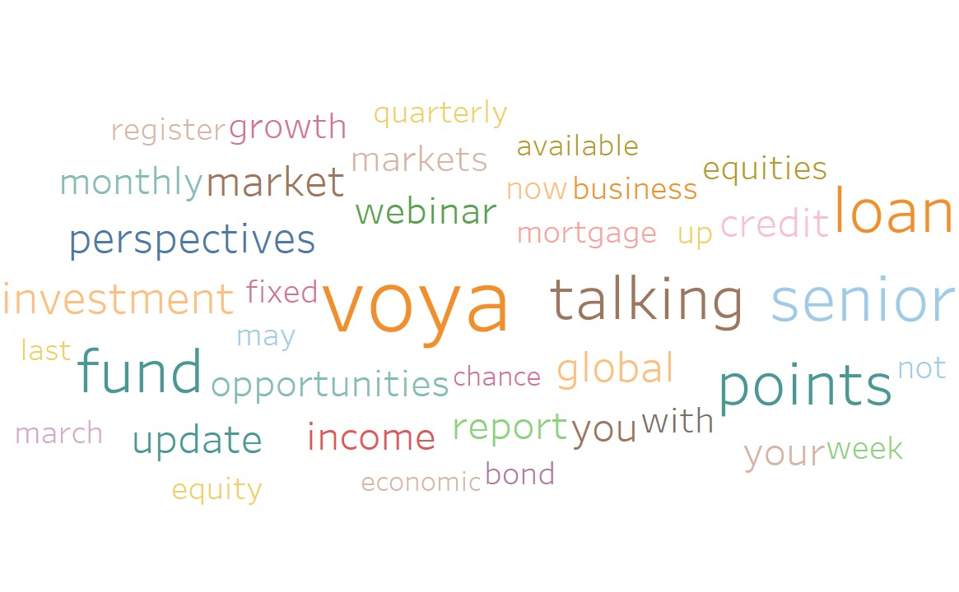
Thank you!

